Slide 1
Type to enter a caption.

Slide 2
OUR 2019

Slide 3
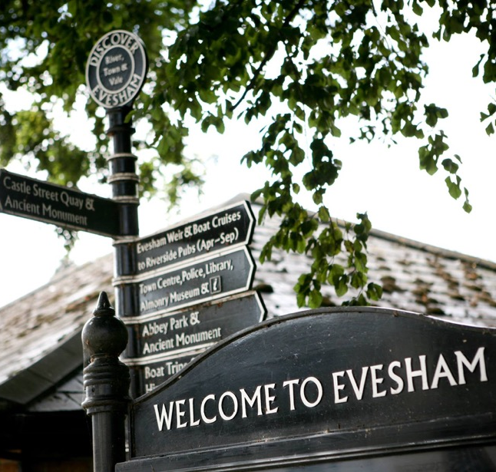
meetings & speakers
14 fascinating speakers
Robin Walker
Cycle Evesham Vale
Peter Lee-Smith
Citizens Advice 80th & Evesham Walking Festival
Chris Haynes
Greening Evesham
Clive & Gill Stewart
Evesham Light Festival
Mick Hurst
Battle of Evesham
Sue Ablett
Evesham Festival of Words
Fiorinda Tocchini & Helen Cameron
Worcestershire Food & Drink
Andrew Plimmer
Northwick Hotel (Worcestershire Business Expo)
John Porter
Evesham Food Group
Barrie Baldelli
Evesham Abbey Trust
Karen Robinson
Evesham United FC
Cllr Mark Goodge
Mayor or Evesham
Diane Bennett
Caring Hands in the Vale
Notes:
Throughout 2019, our meetings have been packed with insight about our town and we’ve welcomed 14 different speakers to help keep our fingers on the pulse.
We have learned lots about our fellow members and their businesses and the excellent work of local charities and community groups.

Slide 4
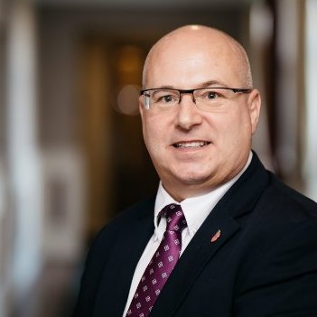
RAISING VECTA’s PROFILE
Social media
Almost 3,000 regular followers
Facebook reach of over 14,200 (2019)
Stuart Allen #WorcestershireHour
Type to enter a caption.
Notes:
Our Secretary, Natasha Wooldridge has proved a great asset to the VECTA committee this year, successfully managing and boosting our social media presence.
Posts on our Facebook page reached over 14,200 people in 2019 and with almost 3,000 social media followers, we now have an established and growing platform to promote our work and the events that we support.
We have also established a strong presence on Twitter, taking over the running of #EveshamHour from The Evesham Observer and bringing it to life with lots of regular contributors engaging each Thursday evening between 8-9pm.
VECTA have also arranged and hosted two social media training events, including a session led by renowned #WorcestershireHour founder and sales trainer, Stuart Allen, kindly hosted and supported by new VECTA members, Squab Storage.

Slide 5
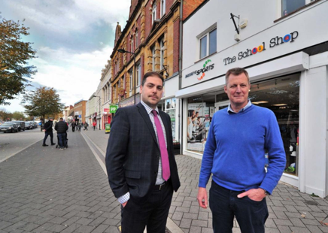
RAISING VECTA’s PROFILE
Media coverage
Type to enter a caption.
Notes:
Following the publication of a lazy negative news article, featuring an established local retailer, on the front page of the Evesham Journal, we were able to persuade the paper to follow up with a very positive front-page feature, about how Evesham's thriving independent businesses are helping our town to buck the national trend.
I was also invited by BBC Hereford & Worcester to contribute to their discussion about business rates on their breakfast show, which was an interesting new experience for me. Not least having to be up and alert for a 7am interview.

Slide 6
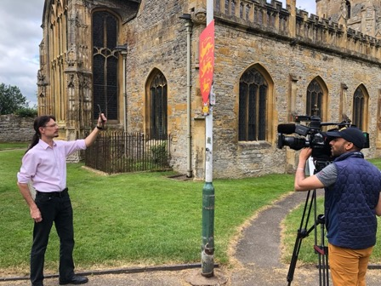
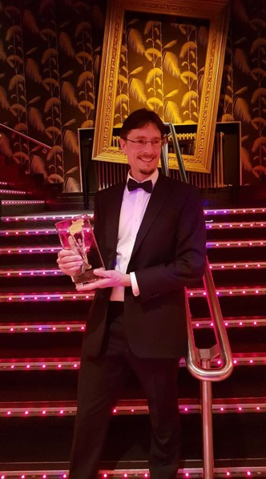
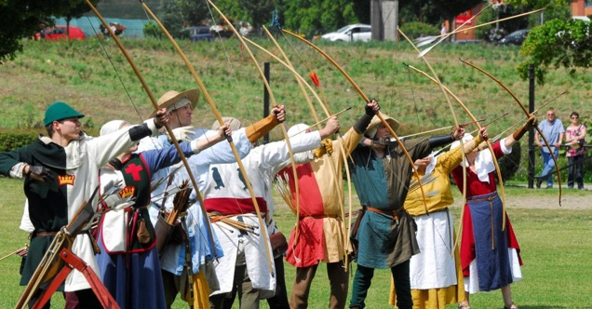
EVENTS
17,000+ VISITORS
Type to enter a caption.
Notes:
VECTA Vice-Chair, Mick Hurst has enjoyed a glittering year, collecting a prestigious Midlands Business Award for his local business, ARECA Design. But his greatest success of 2019 has surely been the Battle of Evesham Festival, attracting over 17,000 visitors to Evesham in a single weekend. Media coverage of the event also raised Evesham’s profile, including a feature on BBC Midlands, and has since led to nominations for local tourism awards.

Slide 7
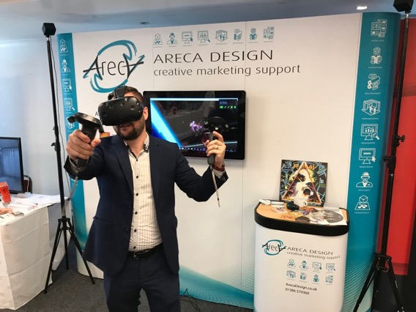
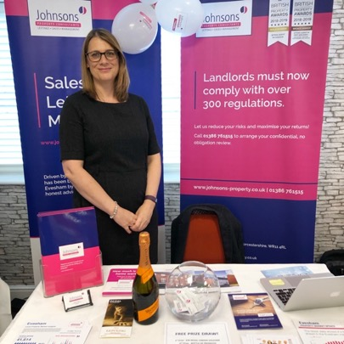
EVENTS
Notes:
Back in the summer, the Worcestershire Business Expo came to Evesham. Hosted here at the Northwick Hotel, the event attracted businesspeople from Worcestershire and beyond and exhibitors included VECTA and several of our member businesses.

Slide 8
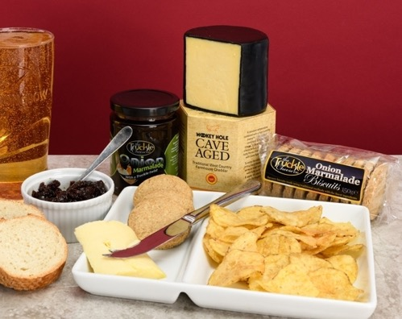
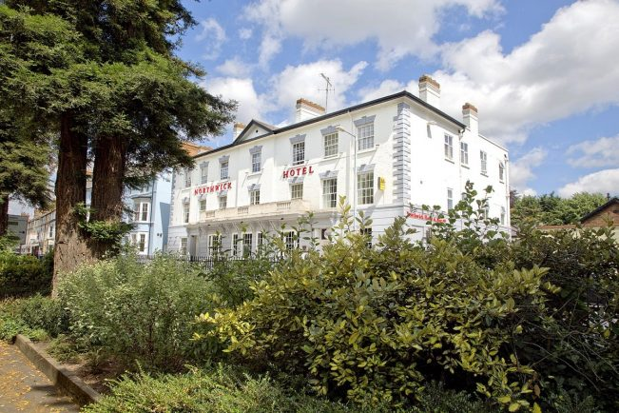
EVENTS
Type to enter a caption.
Notes:
The VECTA Summer Garden Party morphed into a successful indoor cheese and wine evening as we welcomed new faces; some of whom have since become members or are due to join us shortly.

Slide 9
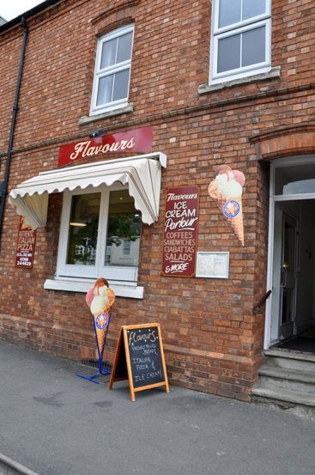
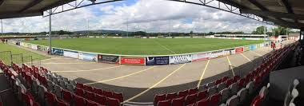
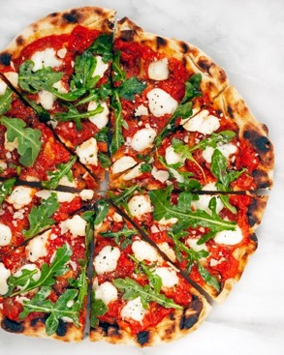
EVENTS
Type to enter a caption.
Notes:
We were hosted at Evesham United FC by Karen Robinson for one of our networking events, which included a tour of the club’s ground and impressive facilities.
Our Christmas Dinner at Flavours was also a great success. The evening was a real treat for those of us who were yet to discover this little gem on our doorstep, voted Wychavon’s Favourite Restaurant in the Worcestershire Vale & Spa 2019 poll, earlier in 2019.

Slide 10
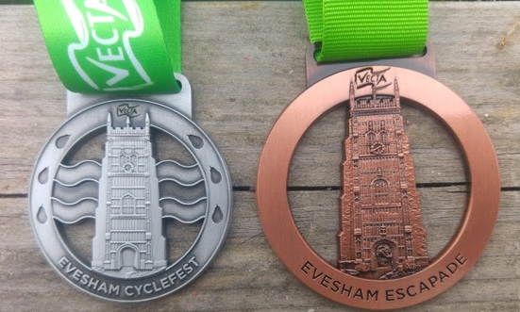
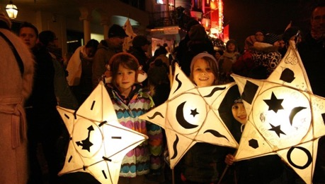
local support
Evesham Cyclefest
Type to enter a caption.
Evesham Light Festival
Notes:
VECTA has continued to support local events, including Evesham’s Festival of Words, The Battle of Evesham Festival and Evesham Cyclefest, with grants going towards brochure printing costs, materials to make shields displayed around Evesham and award medals.
VECTA have also supported the social media promotion of local initiatives and events, including Greening Evesham and Evesham Light Festival.

Slide 11
PARTNERSHIPS
Notes:
We continue to work closely with both the Town Council and Wychavon District Council and councillors regularly attend our monthly meetings, providing us with updates on the latest developments. This year VECTA has been represented on Wychavon’s Transport Committee and have given our input on the Evesham traffic situation.
I was also recently given the opportunity to speak to Wychavon District Council’s Town Centres Advisory Panel during their one-day visit to, and tour of, Evesham. In their feedback from the day, the panel described VECTA as “an excellent example of an effective local chamber of commerce".
Following my recent meetings with passionate local campaigner Bruce Taylor, we have pledged our support to the Evesham Anti-Litter Campaign Group and we are already working with them to encourage local traders and landlords to do their bit to improve the impression of Evesham given to visitors, by clearing up their own patch. A walk around town with Bruce really opened my eyes; from seeing some of the ‘grot spots’ to realising the great opportunity for all of us to improve the local environment in which we live, work and do business.

Slide 12
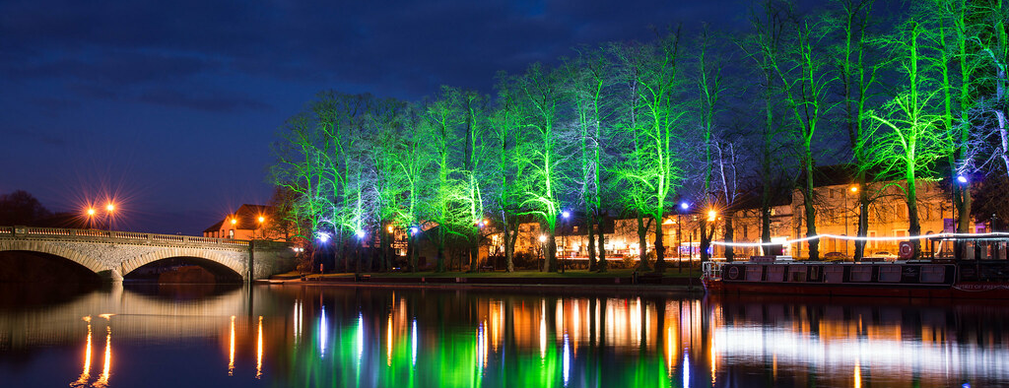
“…a more vibrant and attractive
place to live, work and thrive.”
Notes:
Finally, a big Thank You!
The 2019 VECTA committee has been a pleasure to be a part of.
Mick Hurst – Vice-Chair & acting Treasurer, along with his wife Sue, has done an exceptional job of supporting and promoting VECTA, while also kindly hosting our monthly committee meetings at his impressive new town centre offices.
Natasha Wooldridge – Secretary and social media and communications guru brings great enthusiasm to her role and successfully keeps us all well-organised.
Penny Preston – who I’m really pleased to have alongside me on the committee. My right-hand woman at Johnsons, it was Penny who encouraged me to take up this role and she has been a great support throughout 2019.
Adrian Nichols – A long-term supporter of VECTA, who continues to bring enthusiasm and experience to our meetings, as well as being a very generous donor of delicious cheeses for our networking events.
Karen Meadows – As a local business owner, now almost a ‘professional networker’ and an active member of Worcestershire Food & Drink, it’s great to have Karen’s support and expertise.
And… Charlotte Perry – Now a Partner at Parkinson Wright, Charlotte joined the VECTA committee back in the summer. It’s great to have her on board and I hope she will continue to work with us into 2020.
Finally, a huge Thank You to all of you, VECTA members, who continue to support our work and attend meetings to share your views, ideas and experience.

